Slide 1
Fact-Checking Health Claims Using Transformers and RAG Techniques
Batch No: 22
Team Members:
Balamurugan K (211521243030)
Dinesh S (211521243049)
Lakshmikanth R (211521243095)
Guided By:
Professor Name & Degree
Designation
Department Of Information & Technology
Panimalar Institute Of Technology

Slide 2
Abstract
Develop an AI-based system using Transformers and Retrieval-Augmented Generation (RAG) to verify the accuracy of medical claims from user-provided text inputs.
The system extracts medical entities from the input text using NLP techniques and queries trusted databases like PubMed, WHO, and UMLS to retrieve relevant information for fact-checking.
It categorizes the claims as "Factual," "False," or "Insufficient Evidence," providing users with real-time verification based on evidence-backed sources.
This solution aims to reduce the spread of medical misinformation, enhancing the reliability of health-related content on digital platforms.

Slide 3
Literary Survey
S. No | Year | Title | Author | Merits | Demerits
1. | 2020 | HealthFC: A Benchmark Dataset for Medical Fact-Checking | M. Kotonya, F. Toni | Provides a labeled dataset for medical misinformation detection | Limited coverage of diseases and treatments
2. | 2021 | PubHealth: A Dataset for Evidence-Based Fact-Checking in Healthcare | W. Zhong, M. Enayet | Includes detailed evidence for health-related claims | Requires high-quality training data for accuracy
3 | 2022 | Transformer-based NLP Models for Health Misinformation Detection | A. Gupta, R. Sharma | Improves classification of misinformation over traditional ML models | Struggles with complex claims needing external evidence
4 | 2023 | Integration of BioBERT and Knowledge Graphs for Fact-Checking | K. Wang, L. Chen | Improves interpretability and reasoning in fact-checking models | Requires extensive knowledge base updates
5 | 2024 | Proposed System: Fact-Checking Medical Claims Using BioBERT + RAG + LLM | Dinesh S, Bala Murugan K, Lakshmi Kanth R | Combines entity extraction, evidence retrieval, and contextual explanations for accurate verification | Requires cloud-based infrastructure for scalability

Slide 4
Existing System
Health claims are traditionally verified manually by medical professionals using research papers and clinical trials, making the process slow and resource-intensive.
Some automated tools use general NLP models like BERT, which are not specifically trained for medical contexts, leading to reduced accuracy in understanding complex medical terminology.
Most current systems do not directly utilize clinical trials or systematic reviews, instead relying on general scientific publications or user-generated content, which may not be reliable for accurate medical verification.

Slide 5
Proposed System
Deep Learning Models
Utilizes BioBERT for entity extraction and RAG (Retrieval-Augmented Generation) for retrieving and verifying medical claims against credible sources.
Data Integration
Expands sources to include PubMed, WHO, and UMLS for comprehensive medical information retrieval, with user feedback incorporated to improve classification accuracy over time.
Methodology
BioBERT identifies key medical entities within user-submitted claims.
RAG retrieves relevant information from trusted databases and assesses the evidence to confirm or refute the claim.
The system classifies claims as Factual, False, or Inconclusive, and provides real-time results through a web interface.
Advantage
Enhanced verification accuracy through BioBERT and RAG, real-time processing, and ongoing improvement with user feedback.

Slide 6
System Requirements
Hardware Requirements:
Processor: Intel i5/i7 or Ryzen 5/7 (Quad-core or higher)
RAM: Minimum 8GB (16GB recommended for faster processing)
Storage: At least 100GB SSD (to store model weights and datasets)
GPU: NVIDIA RTX 2060 or higher (for deep learning tasks)
Software Requirements:
Operating System: Windows/Linux/MacOS
Programming Language: Python 3.8+
Libraries: TensorFlow, PyTorch, Hugging Face Transformers
Database: PostgreSQL or MongoDB
Frameworks: FastAPI for API development
Cloud Services: AWS/GCP for scalable deployment

Slide 7
System Architecture
User Input: User submits a medical claim.
Preprocessing: Tokenization, stop-word removal, entity extraction.
Evidence Retrieval (RAG): Fetches data from medical databases.
Claim Classification: Categorizes the claim into true, false, or insufficient evidence.
Contextual Explanation (LLM): Suggests alternative perspectives.
Output Generation: Presents results with sources.

Slide 8
List of Modules
User Input Processing – Accepts and preprocesses user queries
Medical Entity Extraction – Uses BioBERT for identifying diseases, drugs, and symptoms
Evidence Retrieval – RAG model fetches articles from PubMed, WHO, UMLS
Claim Classification – Categorizes the claim as "Factual," "False," or "Insufficient Evidence"
Contextual Explanation – LLM generates alternative suggestions
User Interface Module – Displays results with sources

Slide 9
Algorithm
Fact-Checking Algorithm using BioBERT + RAG + LLM
Input Claim: User enters a health-related claim.
Preprocessing: Remove stopwords, tokenize, and normalize text.
Entity Extraction: BioBERT extracts key medical terms.
Query Formulation: Create structured search queries using extracted entities.
Evidence Retrieval (RAG): Searches PubMed, WHO, and UMLS databases.
Claim Classification:
Factual: If evidence strongly supports the claim.
False: If evidence contradicts the claim.
Insufficient Evidence: If no strong evidence is found.
Contextual Suggestion (LLM): Generates additional insights if needed.
Output Generation: Displays final result with cited sources.

Slide 10
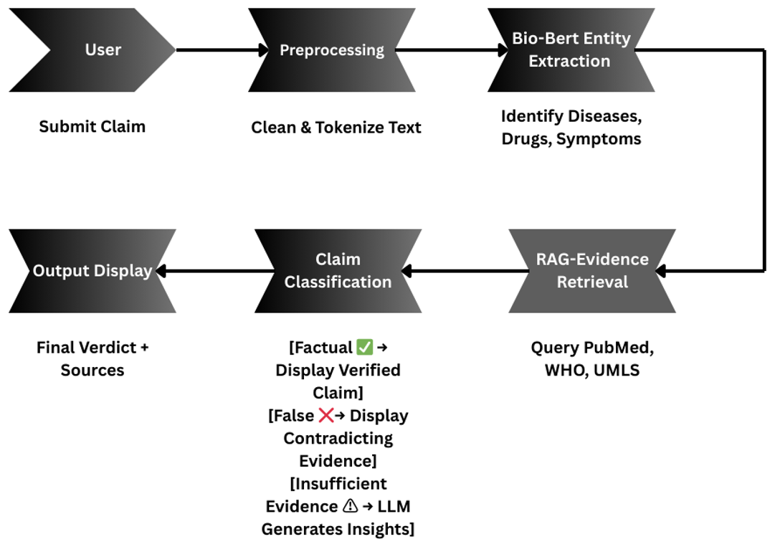
Workflow Diagram

Slide 11
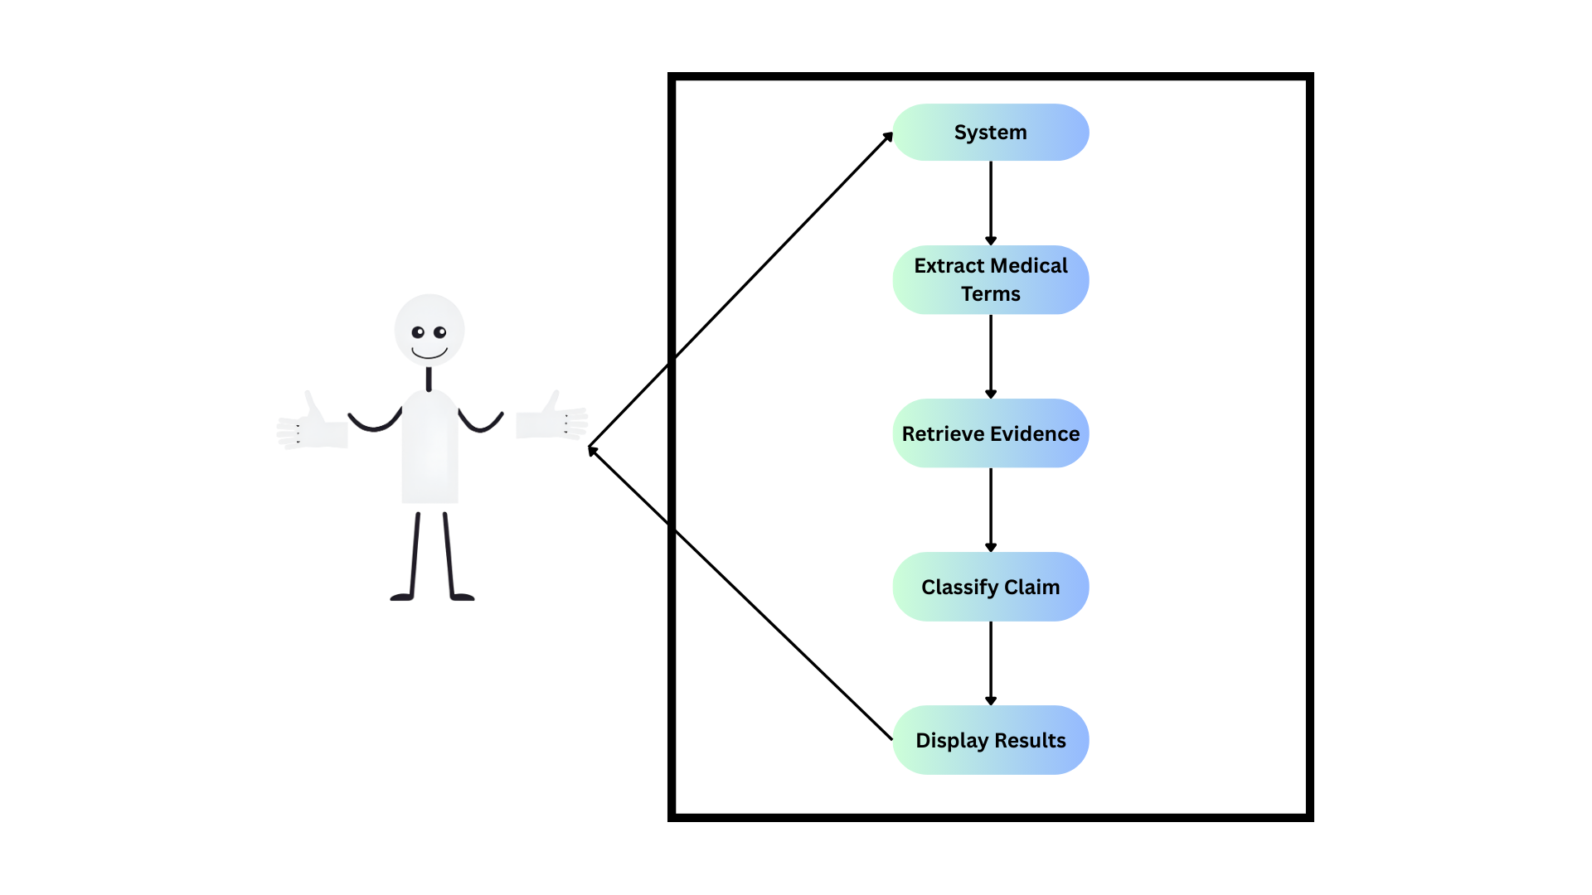
Use-case Diagram

Slide 12
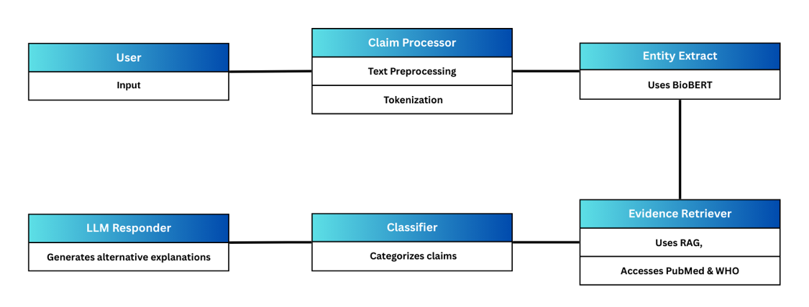
Class Diagram

Slide 13
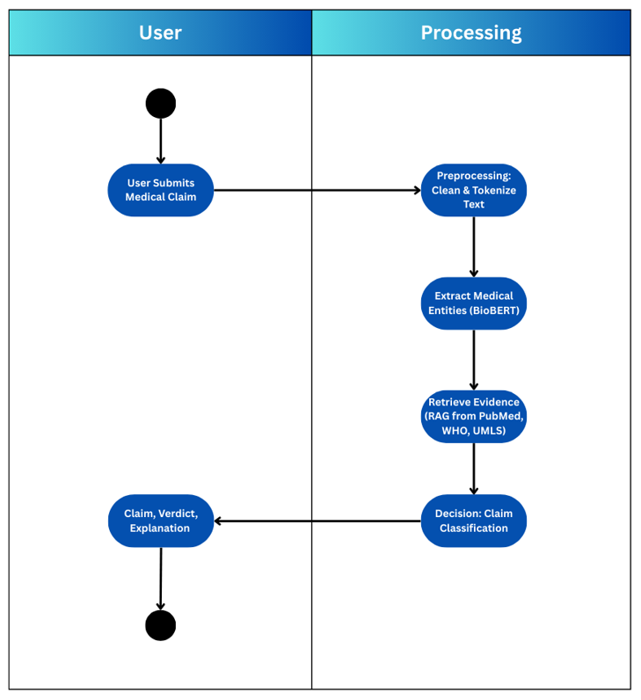
Activity Diagram

Slide 14
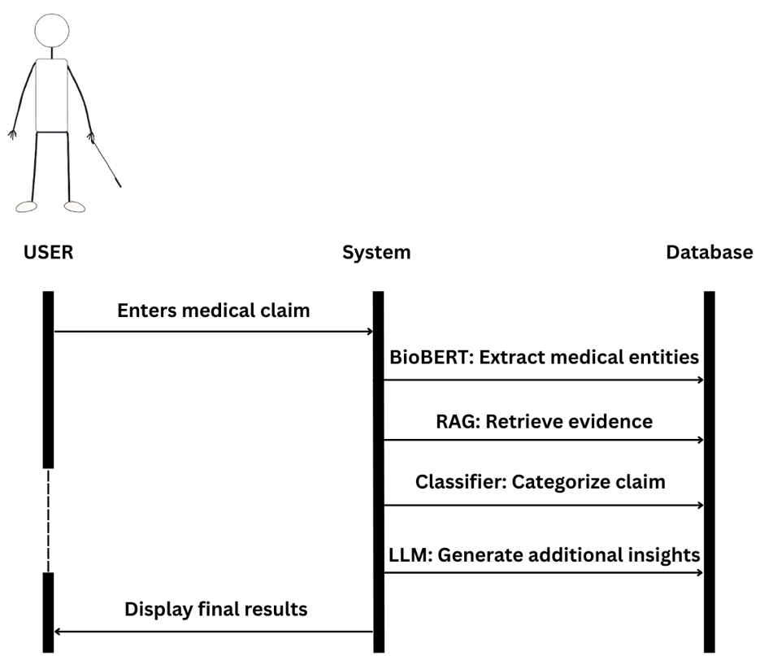
Sequence Diagram

Slide 15
Entity Relationship Diagram
User
Claim
Evidence
Source

Slide 16
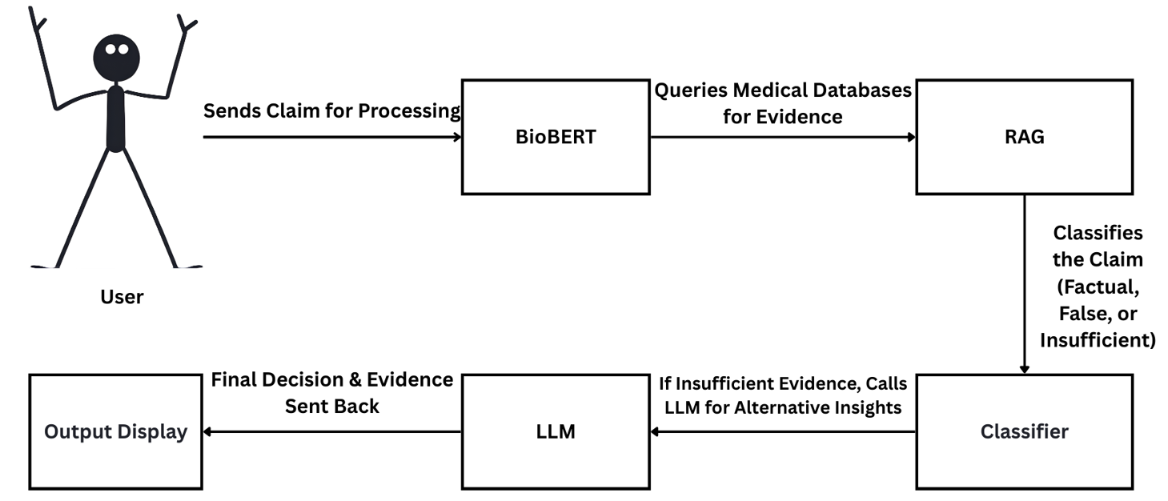
Collaboration Diagram

Slide 17
Advantages
Automation – Reduces manual effort in fact-checking
High Accuracy – Uses domain-specific NLP models
Scalability – Can verify multiple claims simultaneously
Evidence-Based – Retrieves real-time data from trusted sources
User-Friendly – Provides clear classifications with sources

Slide 18
Future Enhancements
Multilingual Support – Expand to non-English medical claims
Integration with Health Apps – API support for mobile health applications
Voice-Based Queries – Enable fact-checking via speech input
Blockchain for Data Integrity – Secure and transparent medical data verification

Slide 19
Conclusion
Developed an AI-powered medical fact-checking system.
Integrated BioBERT, RAG, and LLM for high-accuracy verification.
Real-time, scalable, and evidence-based approach to tackle misinformation.
Future improvements include multilingual expansion, mobile support, and blockchain security.

Slide 20
References
Key Papers & Sources:
BioBERT: Lee et al., 2020
RAG Model: Lewis et al., 2021
Medical Datasets: PubMed, WHO, UMLS
Transformer NLP: Vaswani et al., 2017

Slide 21
Thank you

